Slide 1
Hate Speech Detection Using Natural Language Processing Techniques
Team No: 3
Name: F M Tahoshin Alam
ID: 18101030
ST: Ehsanur , RA: Sabbir

Slide 2
Introduction:
Hate speech is defined as any speech or expression that attacks a person or a group on the basis of their race, ethnicity, national origin, religion, sexual orientation, gender, or other characteristics.
Detecting hate speech is important because it can have a negative impact on individuals and society as a whole. Hate speech can lead to discrimination, harassment, and even violence.
However, detecting hate speech using natural language processing (NLP) is challenging due to the ambiguity of hate speech and the need for annotated datasets.

Slide 3
Challenges:
Hate speech is not always clear-cut and can vary based on the context and cultural nuances.
Developing a dataset of annotated examples of hate speech is difficult, time-consuming, and expensive.
There is also a need for more annotated datasets in different languages and cultures.
Hate speech can be implicit and expressed through subtle cues, making it difficult to detect using NLP.
The same language can have different meanings based on the context in which it is used, making it challenging to develop a single algorithm that can detect all instances of hate speech

Slide 4
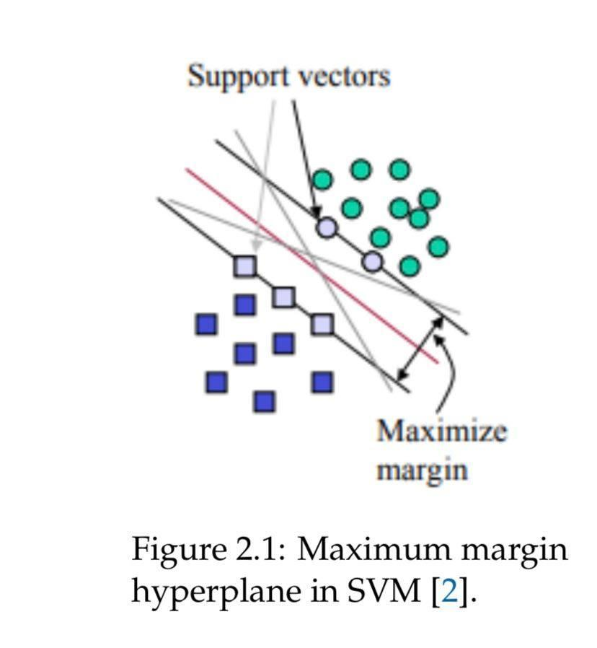
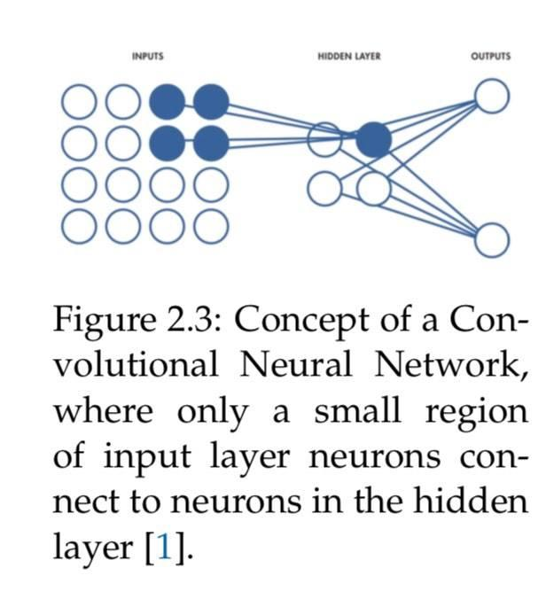
Techniques:
Traditional machine learning models (e.g., SVM, Naive Bayes)
Deep learning models (e.g., CNN, RNN)
Hybrid approaches (e.g., combining rule-based and machine learning models)

Slide 5
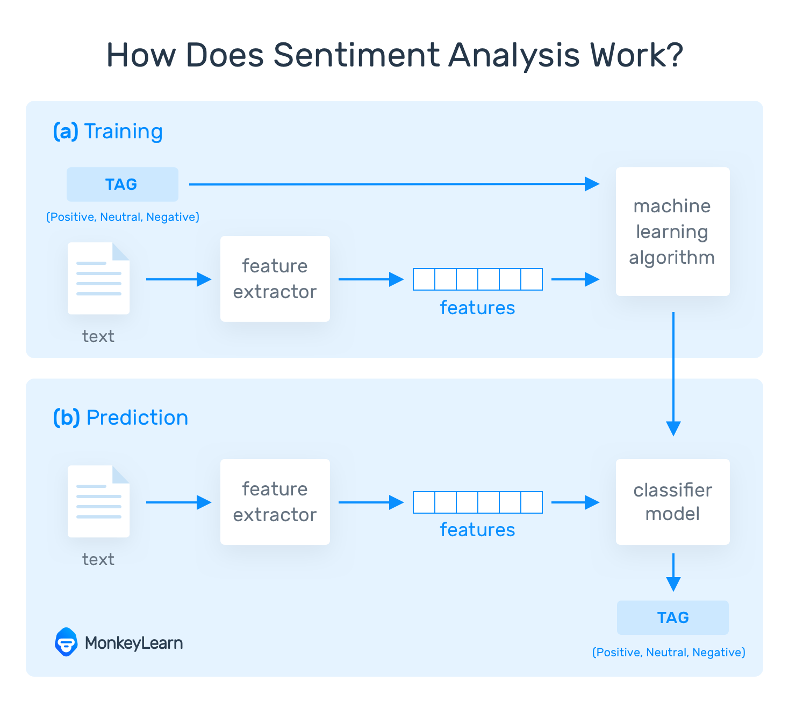
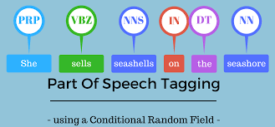
Natural language processing techniques:
Part-of-speech tagging
Named entity recognition
Sentiment analysis
Word embeddings

Slide 6
Evaluation metrics:
Precision
Recall
F1-score
Area under the ROC curve (AUC)

Slide 7
Publicly available hate speech datasets :
Annotated datasets are essential for training and evaluating machine learning models for hate speech detection
HateXplain is a dataset that provides explanations for hate speech, GermEval is a dataset for German hate speech detection, and HASOC is a dataset for hate speech and offensive content in Hindi, English, and German.
limitations of current hate speech datasets

Slide 8
Results :
The model predicting each category with 91% accuracy and a loss of 36%. The final model gives an overall precision of 0.91, a recall of 0.90 and a F1-score of 0.90
This model also incorrectly identified some non-hate speech as hate speech
It did perform better in identifying the offensive class

Slide 9
Conclusion and future directions :
It has provided a comprehensive review of the challenges and techniques for hate speech detection using NLP. and also discussed evaluation metrics, publicly available hate speech datasets, and potential future directions for research in this area.
Future research should aim to address these limitations and improve the accuracy of hate speech detection systems
Possible future directions include developing more accurate and efficient deep learning models, incorporating more advanced NLP techniques such as context-aware sentiment analysis, and exploring the use of explainable AI for hate speech detection.
Developing effective hate speech detection systems is essential for combating these harmful effects and promoting a more inclusive and respectful online community.

